Slide 1

Fake News Detection
Created by team - D@TA K-0$
@AMRITA VISHWA VIDYAPEETHAM

Slide 2
Problem Statement:
It is common these days, twitter is more often used as a platform to spread fake news (since it is more authenticative)
It is being misused for spreading fake news and messages that can lead to communal agitations,fake alarms over natural calamities,hoax information on contagious diseases etc..,using fake social media profiles. A web based tool is to developed to identify such fake accounts and activities and report to government departments concerned.

Slide 3

Proposed solution:
Getting access to twitter using API.
Text or image is given as input to the classifier for its segregation into different categories (accordingly).
Next this news is sent for analysis to get classified into different topic and then this is put into NLP framework.

Slide 4
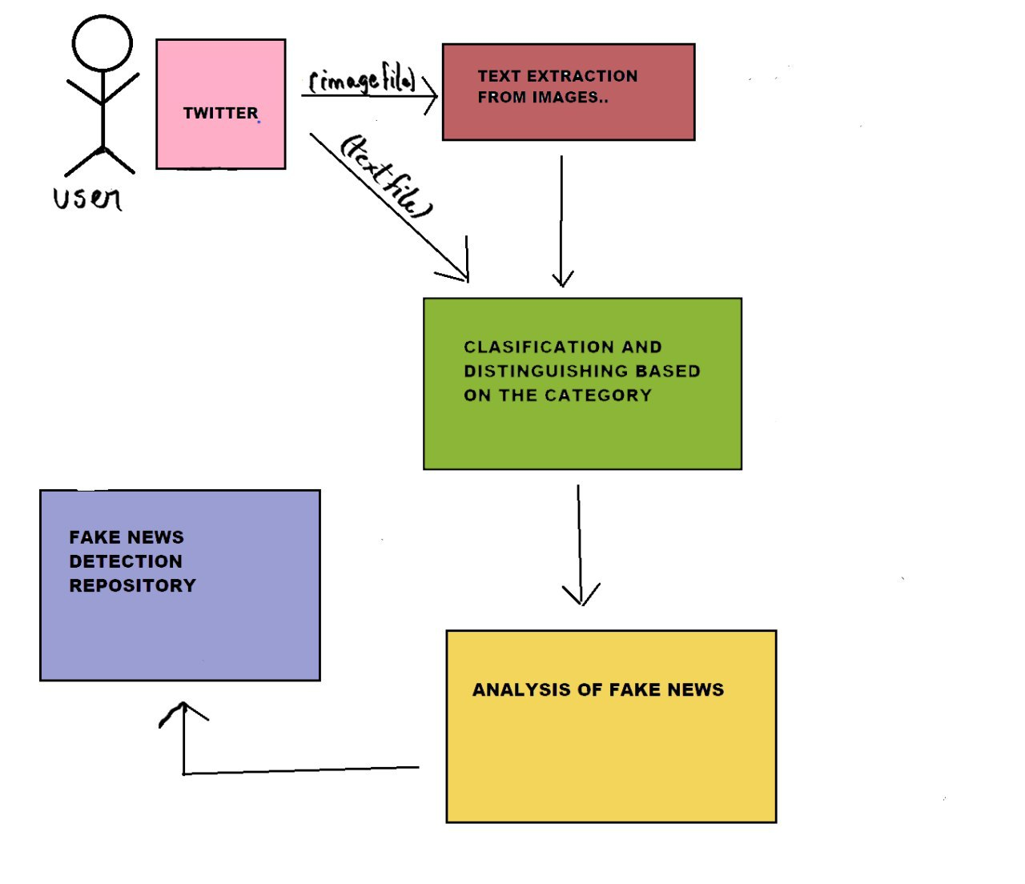
Solution architecture:

Slide 5
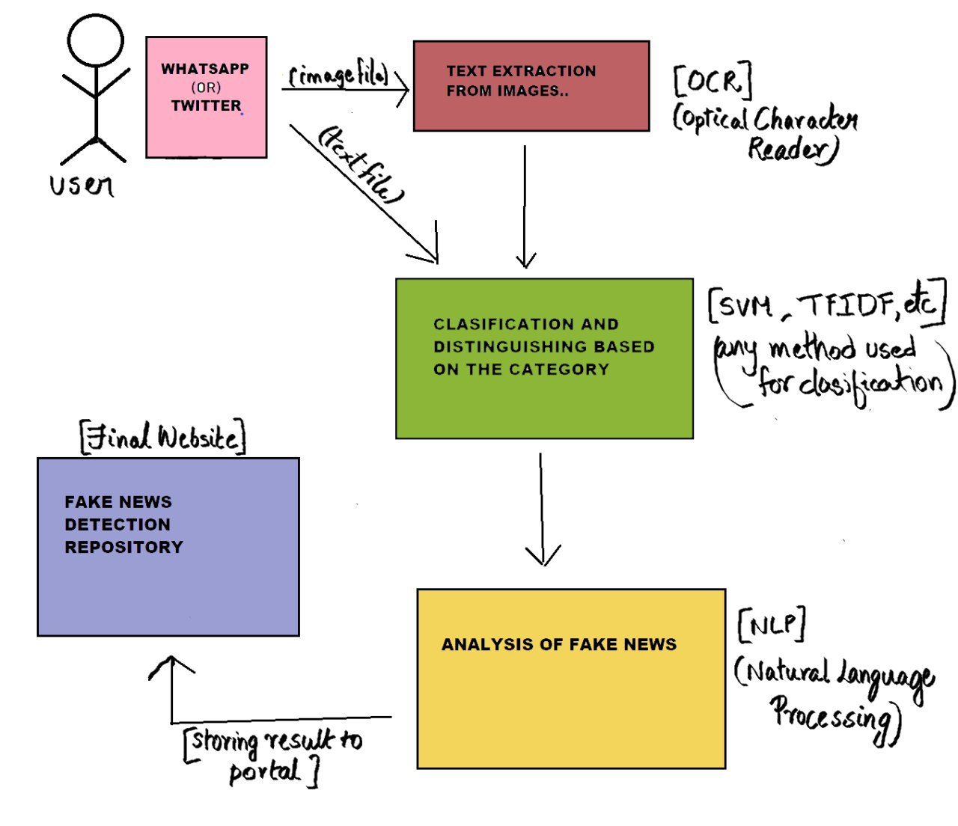
TECHNOLOGY ARCHITECTURE:

Slide 6
Social impact:
User friendly interface
Useful for cyber cell security
Open source ,so more feasible
Prevents fluctuations in the market and unnecessary/fake economic crisis.

Slide 7
Conclusion:
In this model we tried to extract the tweet using twitter API. Later this tweet is made run through the proposed algorithms and results are obtained accordingly.
And next if the tweet came to be fake then that particular account and the other accounts which retweeted it are taken into consideration and examined if they are fake or authenicative.
Later the fake accounts are listed out to either Twitter or Authorities to block the corresponding twitter accounts.

Slide 8
Technologies Used
Twitter API
Tweepy
Natural Language Toolkit - NLTK
Tokenization
Stemming
TF-IDF
Sentiment Analysis
DNN

